Slide 1
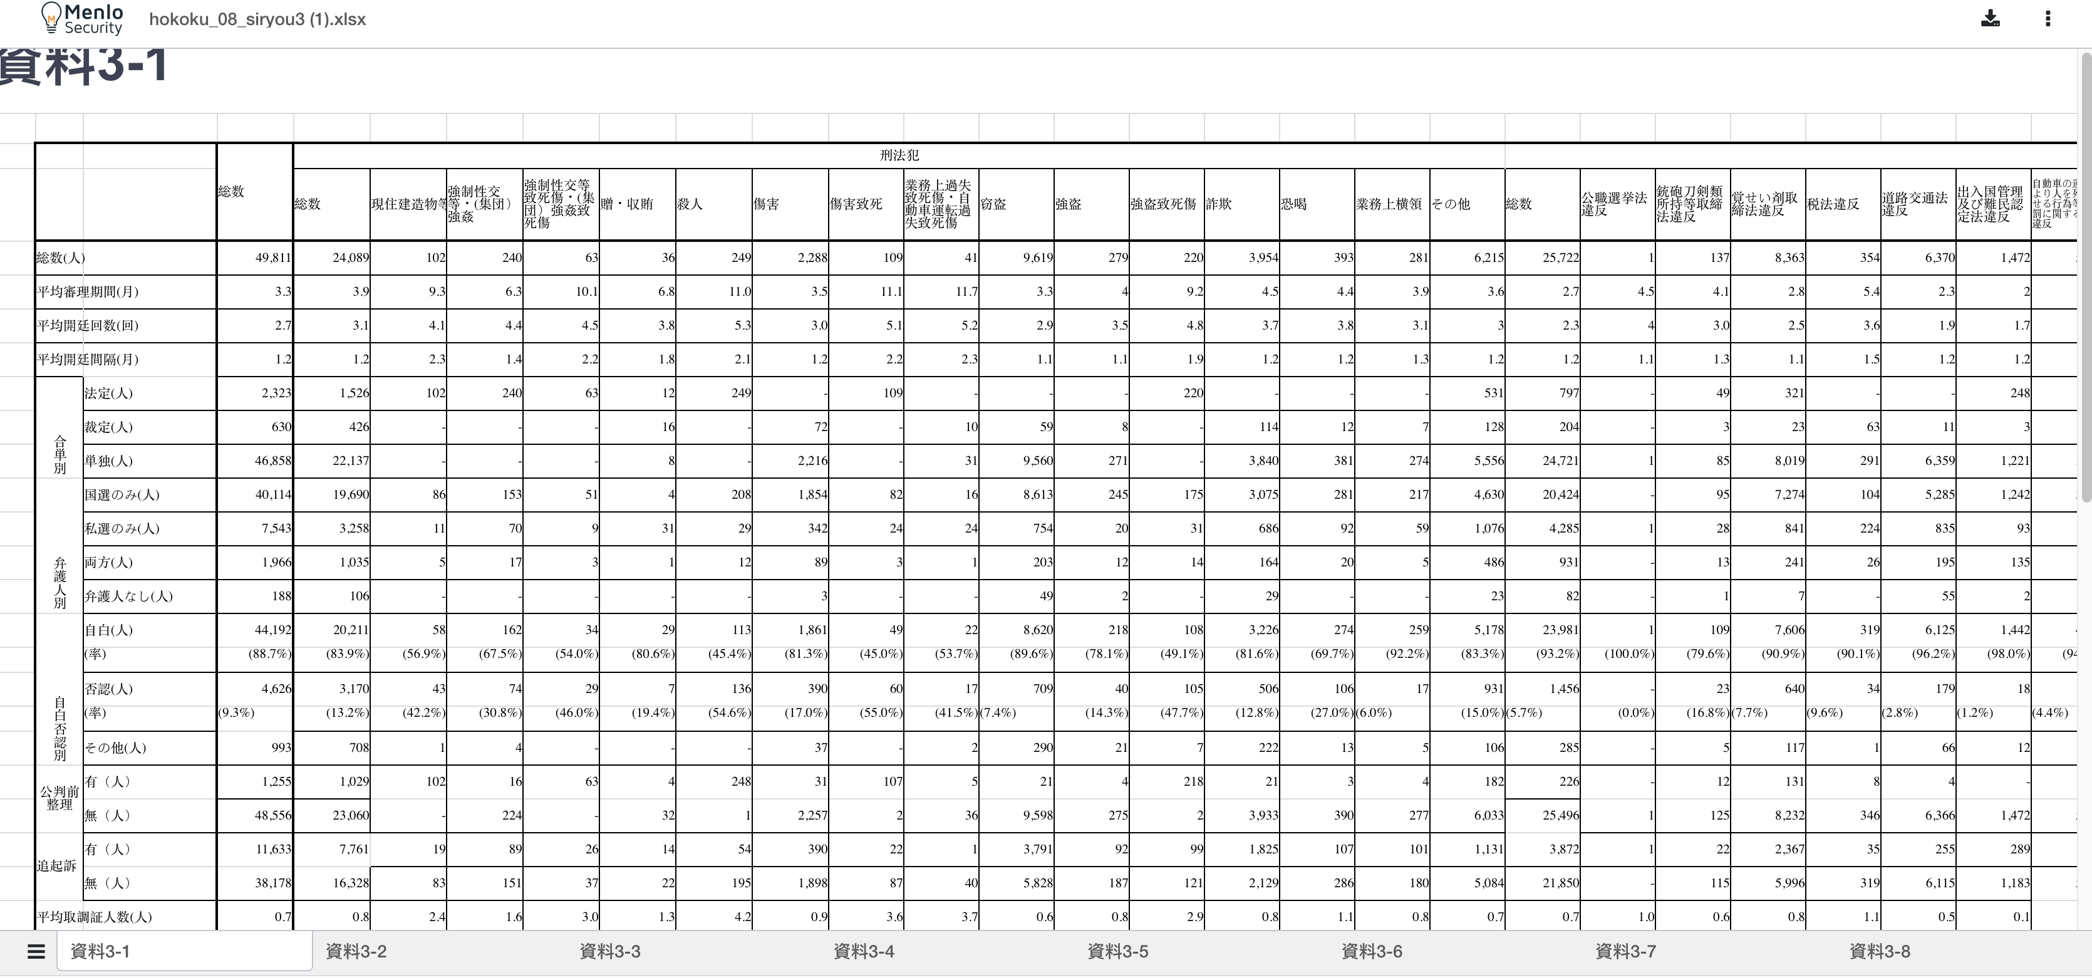
The original document uses MS Gothic but the isolated document uses Mincho.
These text should be centered and equally spaced.
These text should be right-aligned.

